Slide 1
San Mateo County Sheriff’s Office

Slide 2
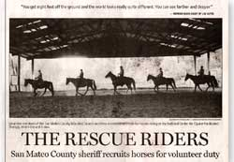
Mounted Search and Rescue Established December 2001

Slide 3
Mounted Search and Rescue
The San Mateo County Sheriff’s Mounted Search and Rescue unit is made up of horse and rider teams certified in 25 skill areas. The unit coordinates closely with other specialized groups during an emergency situation to ensure the best possible outcome.
Currently, the MSAR team has 23 sworn members and 6 pending applications
Because both HORSE and RIDER have to be trained and certified it takes about one year to turn out a new, qualified horse and rider team.

Slide 4
Search & Rescue
With a visual vantage point at about 8 feet from the ground, mounted SAR members have a broader search perspective than searchers on foot, especially in brushy terrain.
Riders on horses can cover far more terrain in a shorter period of time than a man on foot.
A horse is a search partner with highly developed senses of hearing, sight and smell. The horse can alert its rider to the presence of a person, body, or even clothing by a change in behavior.

Slide 5
Search & Rescue
Qualified Horse?
A search and rescue mount, be it horse or mule, must be sound and kept in good condition. A SAR horse should be mature - no younger than 7 years. A horse with a calm, alert disposition is preferable.

Slide 6
A SAR-trained horse can transport injured and equipment
Horse trailers and trucks can transport equipment and be used as barricades

Slide 7
Community service
Ceremonial functions
VIP Events
Funerals
Grand openings
Parades
Educational programs
Stranger danger
Hug a Tree
STAR Camp

Slide 8
Goodwill ambassadors

Slide 9
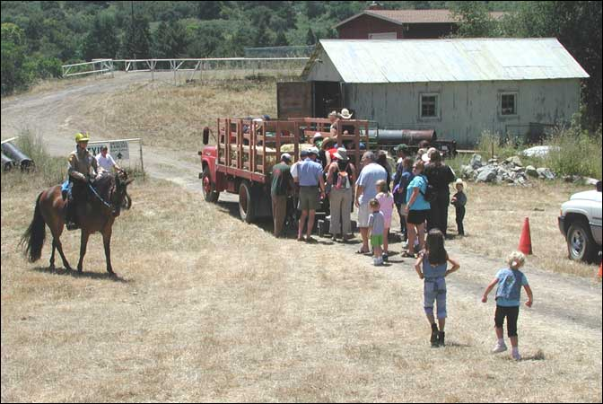
Patrol Duties
Providing a visible presence
Observing Reporting and advising as required
Traffic Control

Slide 10
Large animal rescue
Certified to assist with large animal rescue
Equipped for large animal rescue, and available for large animal evacuations.

Slide 11
Equine behavior training for rescue organizations and law enforcement professionals

Slide 12
San Mateo County Sheriff’s Office
Thank you for your interest in the San Mateo County Sheriff’s Mounted Search and Rescue Team – We Ride So Others May Live

